Slide 1
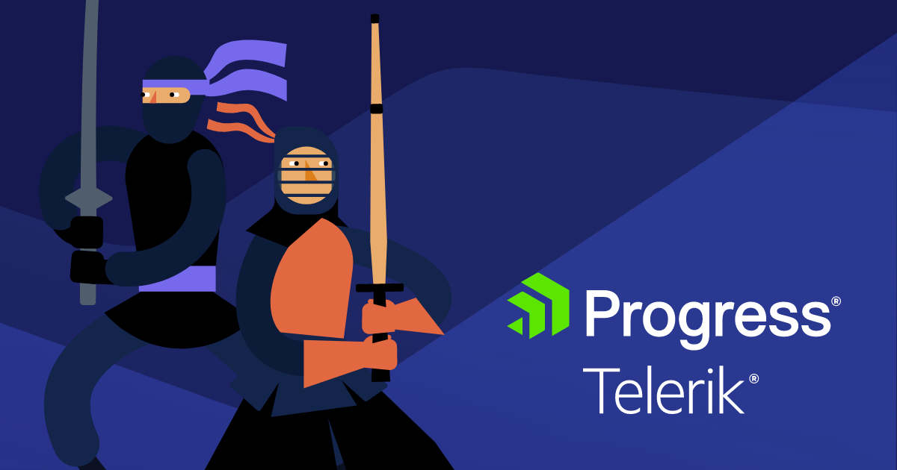


Samar Abu Hdeeb
Computer science graduate,
Student at Athar in an Automation course

Slide 2

Telerik overview
Key Offerings:
Telerik is a software development company that provides tools and technologies to enhance the development of web, mobile, and desktop applications
UI Components: e.g Angular, React, Vue
Kendo UI: focused on delivering JavaScript-based UI components for frameworks like Angular
Reporting and Analytics Tools: Telerik Reporting
Cross-Platform Development:
Provides tools for hybrid and native mobile app development
It is part of Progress Software Corporation and is well-known for its developer-focused products and solutions.
Notes:
aimed at software developers and teams working on application development, Telerik’s tools are designed to save time and provide high-quality, responsive, and modern designs.
Progress Software Corporation תאגידים is a global software company that provides tools, platforms, and solutions for businesses to build, deploy, and manage applications and digital experiences
Kendo UI: A flagship product מוצר דגל focused on delivering JavaScript-based UI components for frameworks like Angular, React, and Vue. מספקת ממשק משתמש המבוסס על גאפה סקריפט לפרימורקים כמו אנגולאר וריאקט
Angular: is a popular open source web application framework developed by google and community of individual (אִישִׁי) developers and corporations (תאגידים - الشركات) it use to build dynamic and modern web applications - it use with css and js

Slide 3

Project Overview
Home page tests:
Account
Contact us
Buttons in home page
Links in nav bar(titles)
Demo page:
Anchors lead to right section in the page
All tests conducted in an OOP manner
Positive + negative tests
Black box testing / E2E
Functionality, GUI
Sanity Test
The reports of result saved in html files

Slide 4

HOME PAGE TESTS
Test titles - (5 methods) for each element in navbar after click at it insure that the correct page is opened with correct title
Buttons - 6 methods, test clicking buttons in home page
Demos - 8 methods of tests in nav bar of Demos page-after click go to correct section

Slide 5
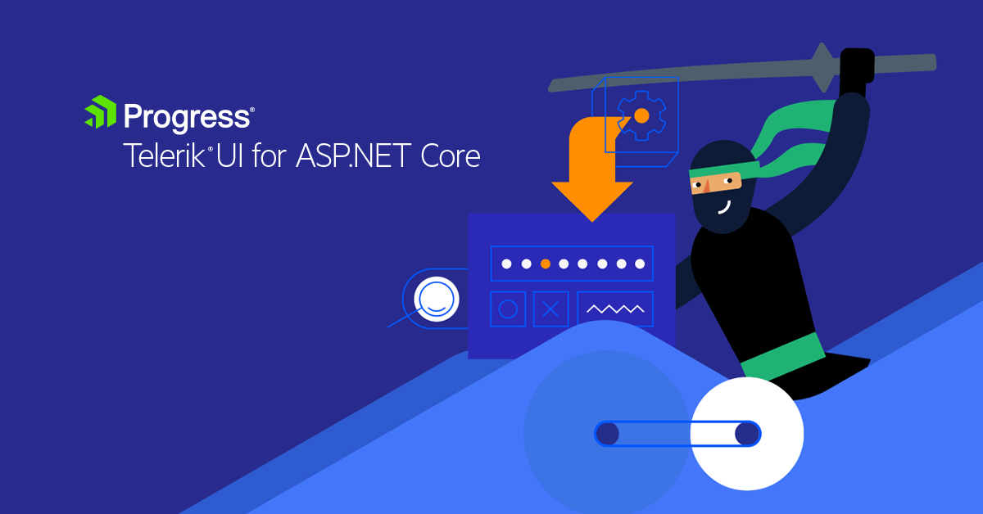
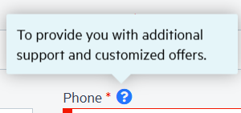

לכל שדה נמצא באחד מFORM יצירת קשר, או חשבון יש שלושה אופציות קיימות:
שדה רק
ערך שגוי
ערך תקין
למשל שדה של השם הראשון המשתמש יכול לא לשים שם (שדה ריק) הכניס שם עם תווים מיוחדים, או שם תקין
ACCOUNT
CONTACT US
Empty field
Symbols
Change email button
Tooltip: phone number field, country fields
Empty fields: password, country
7 methods
Valid input
Empty fields
Special chars and symbols
Tooltip
Invalid
11 methods

Slide 6
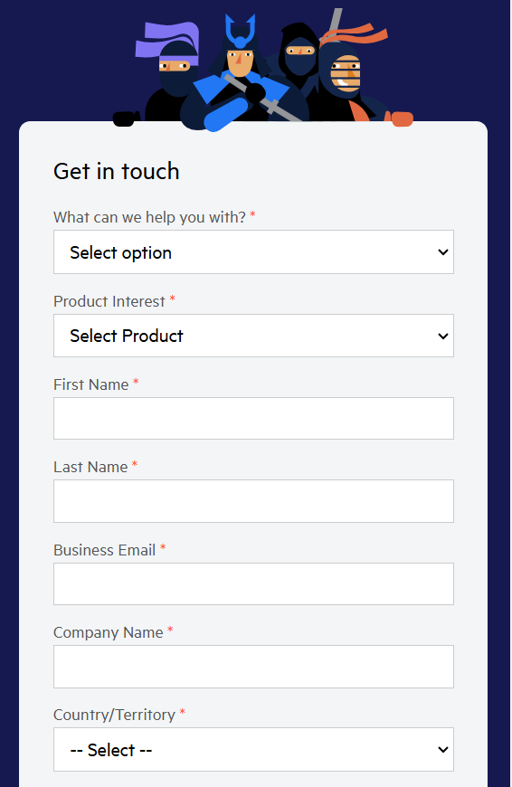


CONTACT US
ACCOUNT
Empty field
Symbols
Change email button
Tooltip: phone number field, country fields
Empty fields: password, country
9 methods
Valid input
Empty fields
Special chars and symbols
Tooltip
Invalid
11 methods
Notes:
לכל שדה נמצא באחד מFORM יצירת קשר, או חשבון יש שלושה אופציות קיימות:
שדה רק
ערך שגוי
ערך תקין
למשל שדה של השם הראשון המשתמש יכול לא לשים שם (שדה ריק) הכניס שם עם תווים מיוחדים, או שם תקין

Slide 7

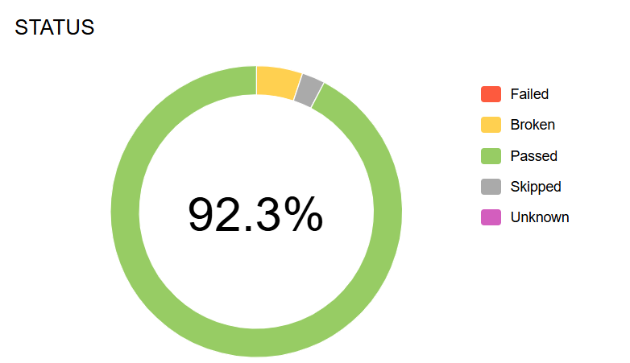
By Allure Report
Notes:
Allure Report is a flexible, lightweight, and popular framework for test reporting in software development.

Slide 8

Frameworks & Libraries:
Selenium
pytest
Report: html, allure
DEMO Github

Slide 9


THANK YOU

